Slide 1
Leveraging what we have for Faster, Safer and More Accessible Payments Bob Steen, Chairman & CEO, Bridge Bank
May 16, 2014

Slide 2
Introduction
Gap Analysis
Paths Forward
Notes:
Thanks Jeff for the introduction.
I’d like to cover three topics today.
Build on Jeff’s introduction of the task force and it’s goals.
Share results of a gap analysis that the Task Force completed as part of it’s self education.
Share thoughts on potential future paths forward.
We’re all “Independent bankers.” That means we each have our own opinions. I’ll work to share the views of the Task Force, but don’t be surprised if as independent banker, I don’t share a few of my own.

Slide 3
Why Technology change, new entrants, and the accelerated pace or rate of change across payment markets give us little choice
Who Community bankers who are deeply engaged to better understand the current state of payments and impacts on the banking industry and who have invested their time in supporting industry leadership groups.
Notes:
Why Did the Task Force Kick-Off?
Industry at an inflection point - Mobile technology and activity
Iowa Banker Leadership - Bob: ICBA and NACHA - Jeff Plagge, ABA Vice Chair, ABA Task Force Chair - Steve Goodenow: FRB Chicago Board
Bob’s Own Experience as Context
NACHA Pilot – I understand how hard it is
NACHA EPS Ballot – I get that we have different views
Check21 – I also get that the industry has brought major improvements forward before.
Like to think of myself as a “glass half full” guy - even if I did some hollering after the EPS vote.

Slide 4
Vision
Financial institutions must equip consumers and businesses to move money instantaneously or as otherwise desired, safely with sufficient privacy and convenience anywhere anytime.
As if one person is moving money between two accounts at a single financial institution.

Slide 5
Competing and Current Paths
Notes:
Again, in spirit of not holding back
Think it’s crucial to remind ourselves of the bigger picture
To send a check, all you needed was mailing address
Going forward, to enable more mobile payments, we’ll need a directory of some sorts
Lot’s of models
Can’t help but note that biggest challenge may be convenience and ubiquity
Looking for in payments what the DNS providers for the internet
Going forward, we’ll also need some mechanism to move money efficiently and safely
There are a number of options
Also need to keep in mind the rules and infrastructures that deliver the confidence and efficiency that we require.
It’s not a simple picture, but each component is important and inter-connected.

Slide 6
Gap Analysis
Approach
Leveraging various ICBA, ABA, FRB, EFT providers & industry leaders using existing rails and core systems
Insights
Speed and service level to end customer
Limitations on innovation and ability to protect consumer
Costs and affordability dimension

Slide 7
Instant vs Reality
Real-time payment processing - a Big leap
Same day or near real time settlement - early or instant messaging achievable

Slide 8
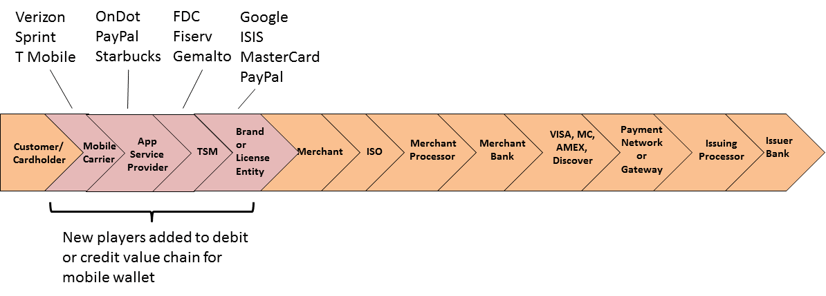
Value Chains Extend
Payment value chains are increasing in length and dependencies.
Ultimately, longer value chains have challenges
Ability to support innovation
Beneficiary choice
Source: MH Consulting payments briefing.
Notes:
When you think about some of the innovations that are occurring at a mind numbing speed, you quickly realize that the way that the market is addressing this gap is often through 8-12 firms coming together and piecing together an end-to-end process.
Good news is that highlights a market need that firms are reacting to
There are a couple of potential challenges
We all know the more firms and hand-offs the more complexity/risk if there are hiccups
We all know that the more firms and hand-offs the more potential for higher ongoing costs (may be very beneficial costs…. I’m not assuming their not). More on costs in a second.
More important and this is very important
To get that money moved when two consumers are not at the same bank, increasingly beneficiaries are being asked to provide sensitive personal information to providers that they have no prior relationship with. Increasingly consumers will be asked to provide this information to more and more firms.
This will limit adoption for some customers who are conservative (or seen past problems)
It also highlights an education need
Next on to the cost equation

Slide 9
New rail discussion
SIC (Switzerland) – integration of retail/low value payments, internationalization
SPEI (Mexico) – accelerated funds availability, multilateral netting, integration of retail/low value payments
STR (Brazil) – integration of retail/low value payments, accelerated funds availability, multilateral netting, internationalization
Xengin (Japan) – convergence ACH & debit, accelerated funds availability, good funds
Advance New Capabilities
Faster Payments (UK) – convergence ACH & debit, accelerated funds availability, good funds, increased access
National Directory (UK) – national directory of mobile telephone numbers intended to enable person-to-person electronic payments
Notes:
I’ve been coming to these and NACHA conferences for years now. It’s mind numbing to keep up with domestic developments let alone international developments. But two quick take-aways from our Task Force Discussions:
Two items of note:
Other markets are over time making investments to either leverage current infrastructures for new purposes, like the Japanese that are leveraging the ACH and ATM networks. Markets like the UK have invested in “new green-field” capabilities. Several folks are in attendance and have and will provide some really helpful insights.
More importantly, it can and is being done.

Slide 10
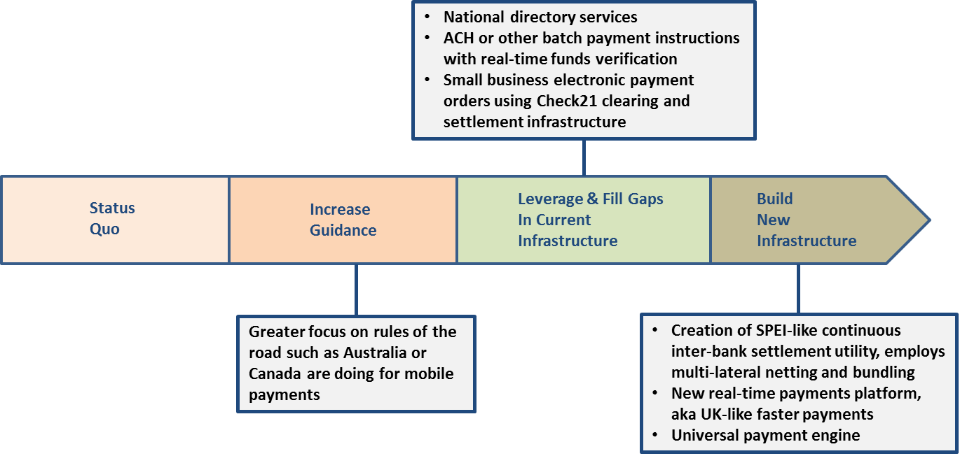
Continuum of Options
Define a continuum of payment innovation choices for peer banks to consider. Options range from staying the industry’s current course through standing-up new payment systems and infrastructure to hybrid options leveraging current infrastructure.
Notes:
With the benefit of this gap analysis, our task force then went to the question of, so what do we do? Pretty quickly come to the conclusion:
You can “wait and see”
You can move forward as individual institutions advancing own goals (many of us are doing this, my bank is…)
You can leverage industry level collaboration
Leverage and enhance current
EPO: End-to-End Check21
Same Day ACH
Japanese ACH/ATM model
Directory tools
Build new
We talked through a handful of options as a group
First, just to better understand as individuals and as a group what the options might be
Second, tried to think through how you would even sort through which are better options
Short answer is it’s not easy…

Slide 11
Connecting the dots
Electronic payment orders using Check21 clearing and settlement
Same day ACH
National directory services that enable banks to process payments
Expanding role or utility of PIN debit networks
ACH or other batch payments with real-time funds verification
New real-time payments platform
Notes:
We came out with three areas at the top of the list
When you think back to slide 5, we as a group concluded that we were looking to find a way to mimic the Internet DNS (domain names system), the ability to deliver interoperability at an industry level, rather than trying to solve via closed loop systems.
We also concluded that there were some ways to take steps forward towards a path like the UK advanced, without going there in one step.
We as a group concluded we needed to get towards more immediate movement of money for our customers and find ways to align revenue streams behind better service levels rather than exception based fees.
It became clearer that there are a number of ways to get there, but increasingly we need to be able to let each of our customers move money as if they were moving money between two accounts at one bank. Simple to say. Would take some work to do. But experience in other markets demonstrates it is doable.

Slide 12
One Banker’s Views
Leverage current capabilities where possible
Focus on industry level approaches
Given network nature and understanding of payments
Build on industry standing (trust, service, adaptive, etc)
Call to Action
Goal defined
Define target timelines
Community Banker buy-in
Notes:
I’ll share more of a personal set of opinions on future success criteria having run through the front end of Check21, having been part of NACHA pilot and having been part of the NACHA extended family during EPS.
Two criteria key
Leverage current capabilities where possible
Focus on industry level approaches
That said, each of us have different points of view, access to different capabilities.
I know the IBA Task Force would be delighted to sit down with others to compare notes on pain points and alternative paths.
Think it’s key to invest in the collaboration required to define a more shared view of future priorities.

