Slide 1
Emerging Payments Task Force Public Hearing Panel #1
Jane Larimer
EVP ACH Network Administration
NACHA – The Electronic Payments Network

Slide 2
NACHA – The Electronic Payments Association
A non-profit association, NACHA manages the development, administration, and governance of the ACH Network. The ACH Network provides the functionality for Direct Deposit and Direct Payment
With the industry, NACHA develops the NACHA Operating Rules, which guide risk management and create payment certainty for all players
The NACHA Operating Rules:
Establish the legal foundation for the ACH Network
Provide a common set of rules and formats
Create certainty and interoperability
Prescribe roles and responsibilities

Slide 3
The ACH Network
Payments are exchanged through the ACH Network using a batch process:
Transactions are accumulated from Originating Depository Financial Institutions (ODFIs) by the ACH Operators throughout the day, sorted, and are made available to the Receiving Financial Depository Financial Institutions (RDFIs) in accordance with published schedules
Settlement is typically on a next-day basis
It is neither a real-time nor an online processing system
Links to virtually every one of the more than 12,000 depository financial institutions in the country – from the largest banks to the smallest credit unions
In 2013, the ACH Network transferred $38.7T via 17.5B transactions

Slide 4
Evolution of the ACH Network
Payroll & Benefits
One-time & Recurring
Consumer Credits
B2B
ACH POS Cards
B2B with Data
Electronic Enrollment
Cross-Border
Check Conversion
Internet & Telephone
Real-time Messaging
E-Invoicing
Mobile
XML Data
QR Bill
The ACH Network has effectively evolved over the last 40 years, and will continue to evolve into the future
1970
1980
1990
2000
2010

Slide 5
The ACH Blueprint – using industry feedback to guide the ACH Network over the next 10 years
Developed in 2012, the ACH Blueprint is a flexible roadmap for change
All types and sizes of organizations
Broad industry-wide survey
50+ Individual interviews over 6 months
ACH Blueprint

Slide 6
The ACH Blueprint – Looking out 10 years
Blueprint “attributes” broadly define areas of future focus and opportunity:
Innovation
ACH Formats
ACH Credit Payments
Routing Data Validation
User Enablement
Cross-Border Interoperability
Remittance Data
Faster Payments
2013-2015 Strategy
2016-2018 Strategy
2019-2021 Strategy

Slide 7
The architecture confirmed in the Blueprint described how it could be implemented
ACH Clearing and Settlement
Preserve current capabilities while making incremental
improvements in speed, IT platforms and formats
Outlined in 2012 ACH Blueprint for the future

Slide 8
Modularly building upon ACH settlement yields functionality, and provides deployment options
ACH Clearing and Settlement
Preserve current capabilities while making incremental
improvements in speed, IT platforms and formats
ACH Clearing and Settlement
Preserve current capabilities while making incremental
improvements in speed, IT platforms and formats
Verification
Routing
Remittance
Data
Outlined in 2012 ACH Blueprint for the future

Slide 9
Modularly building upon ACH settlement yields functionality, and provides deployment options
ACH Clearing and Settlement
Preserve current capabilities while making incremental
improvements in speed, IT platforms and formats
Verification
Routing
Remittance
Data
Real-Time Messaging
Immediate transmission of payment data, access to info services
Outlined in 2012 ACH Blueprint for the future

Slide 10
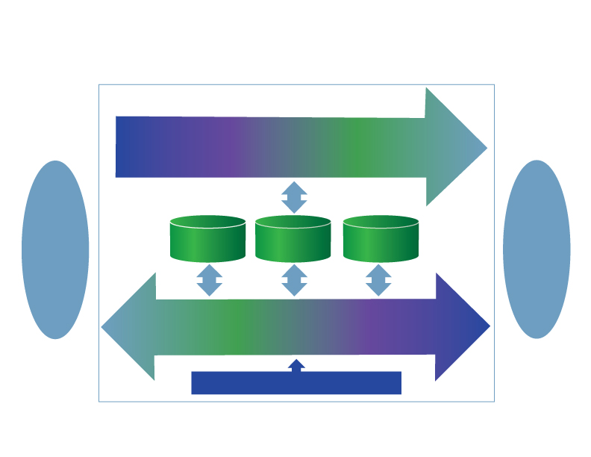
Modularly building upon ACH settlement yields functionality, and provides deployment options
ACH Clearing and Settlement
Preserve current capabilities while making incremental
improvements in speed, IT platforms and formats
ODFI
Verification
Routing
Remittance
Data
RDFI
Real-Time Messaging
Immediate transmission of payment data, access to info services
Third-Party Development Interface
Outlined in 2012 ACH Blueprint for the future

Slide 11
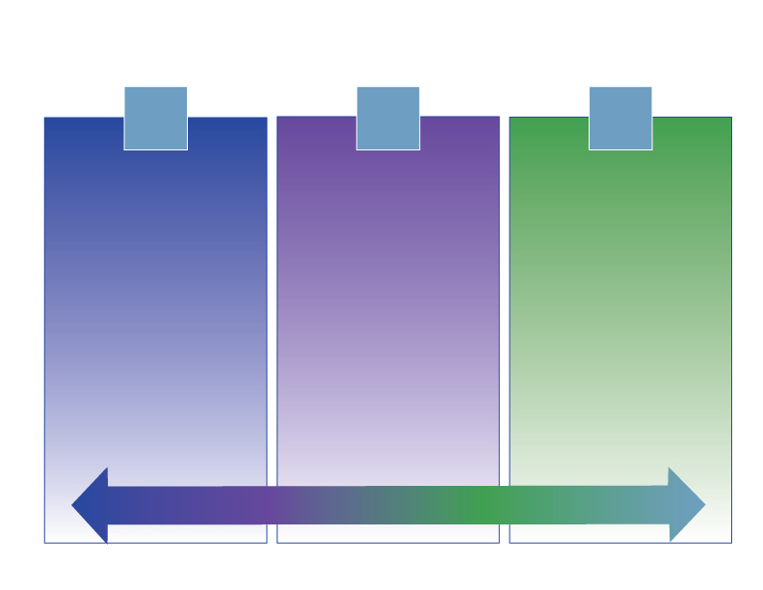
Same-Day ACH Settlement – Phased Implementation
1
2
3
ACH Credits
AM & PM Transmissions
5 PM ET Settlement
ACH Credits and Debits
AM & PM Transmissions
5 PM ET Settlement
ACH Credits and Debits
AM & PM Transmissions
Mid-day & 5 PM ET
Settlement
Faster Funds Availability
Builds functionality over time, adding value to end-users with each step

Slide 12
Regulatory Pressures Build
The Federal Reserve Payment System Improvement Public Consultation Paper sought industry feedback on the future of the payment system
Late summer/early fall 2014 recommendations will be made to industry for modernizing the payment system
At the same time, FIs are facing increasing pressure to protect consumers from unscrupulous actors using the payment systems, while compliance efforts surrounding Dodd-Frank are still being made
Problem: financial institutions have finite resources and are being told both to invest in innovation and to increase controls and compliance (which increases costs)
Managing both very difficult
Ubiquity is essential to be effective

Slide 13
Appendix

Slide 14
The ACH Blueprint attributes align with “filling” the Federal Reserve Consultation Paper payment system “gaps”
Payment System Gaps |  | Alignment with Blueprint Attributes
Continued End-user Check Writing |  | Innovation / ACH Formats / ACH Credits / Routing Data Validation / Remittance Data
Challenges in Converting Businesses to Electronics |  | ACH Credits / Routing Data Validation / Remittance Data
Closed Payment Communities |  | Innovation via Ubiquity of ACH Network
Lack of Contemporary Features in Traditional Payment Channels |  | Innovation / User Enablement / Faster Payments
Slowness of U.S. Payments |  | Faster Payments
Mobile Technology Revolution |  | Innovation / User Enablement / Remittance Data
Obstacles in Intl Payments |  | ACH Formats / ACH Credits
Security Concerns |  | Routing Data Validation / ACH Credits

