Slide 1

CSBS 2023 Data Analytics
Competition
Thomas F. Siems, Ph.D. CSBS Chief Economist
“Office Hours” March 13, 2023

Slide 2
CSBS 2023 Data Analytics Competition
The Challenge (www.csbs.org/data-analytics-competition)
What will be the potential impact on banks (earnings, deposits, asset quality, etc.) from the recent rapidly rising interest rate environment? And how should banks prepare?
The Judging Criteria (see Appendix 1)
Use of data and analytical methods/models
Creativity and innovative thinking
Persuasion through data-driven arguments

Slide 3
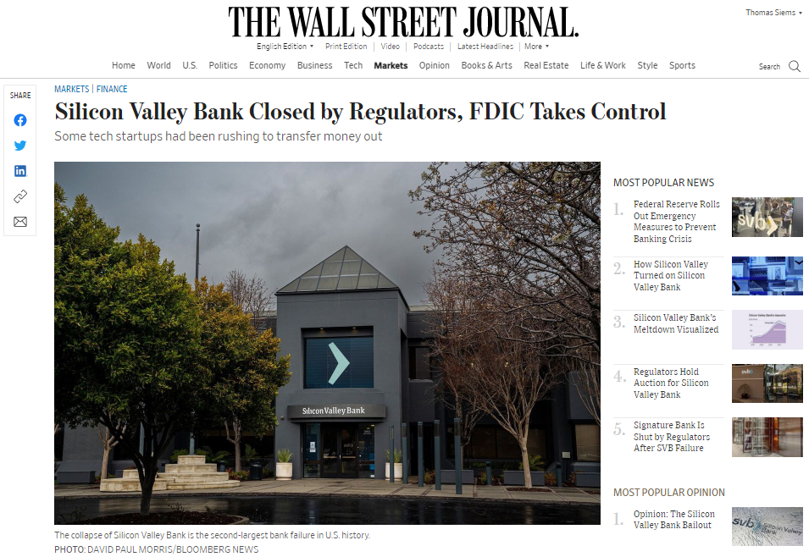
Why the 2023 DAC Prompt is Relevant…

Slide 4
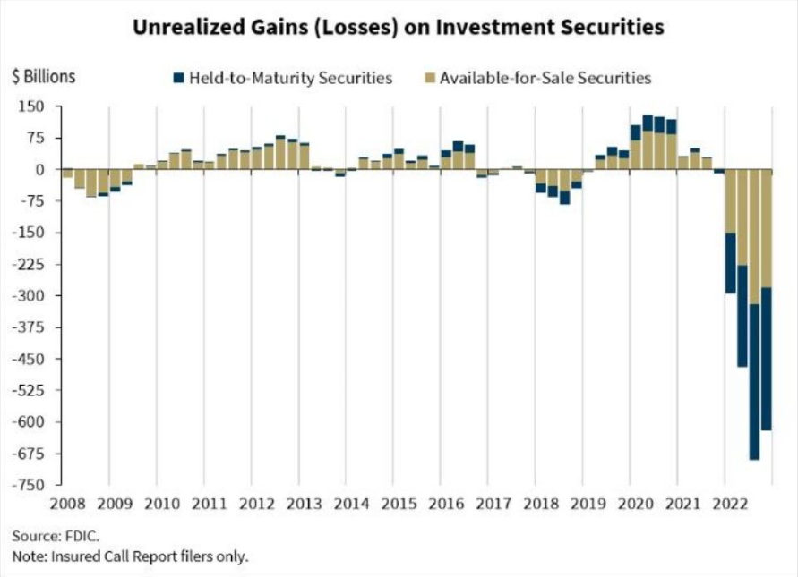
Why the 2023 DAC Prompt is Relevant…

Slide 5
Research Report Writing Tips
Introduction
  Clearly state your thesis/hypothesis (problem/purpose statement)
Literature Review
  What is the state of knowledge/intelligence on your topic?
Methodology
  Technical model; Data sources; Assumptions; Limitations
Results
  What are your findings in relation to your problem statement?
Conclusions, Recommendations, Future Research

Slide 6
CSBS 2023 Data Analytics Competition
Key Dates
“Office Hours” (Feb 13, Mar 13, Apr 10)
Research Reports Due (April 23)
Oral Presentations for Final Four Teams (May 4, 12-2p ET)

Slide 7
Questions?

